Slide 1
Aura Smart Headset V2
Intelligent Neural Noise Cancellation, Lossless Spatial Sound & All-Day Ergonomic Mastery

Slide 2
Disclaimer: About This Document
This document is a speculative sample created exclusively for portfolio demonstration purposes to showcase accessible document creation. “Aura Smart Headset V2” and “Aura Audio Labs” are fictional concepts created for portfolio process only. Any similarity to existing names or products is purely coincidental.

Slide 3
Product Overview
Built for modern hybrid professionals.

Slide 4
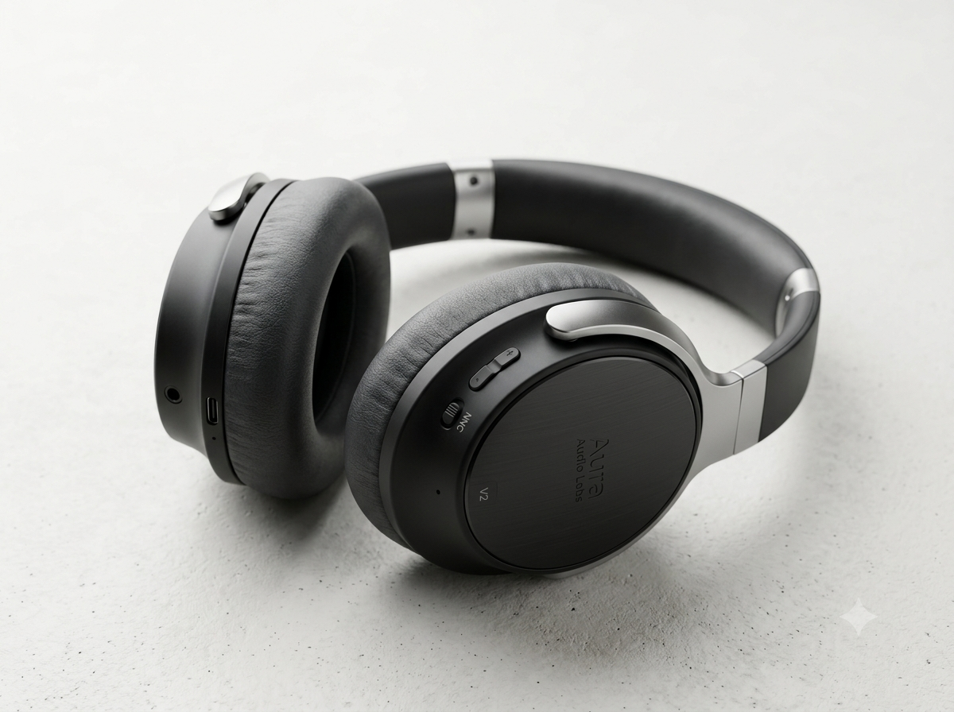
Why Choose Aura Smart Headset V2?
Designed for Focus
Combines Neural ANC 3.0 with custom 40mm drivers.
Unmatched audio performance for hybrid work.
Image generated by Nano Banana 2.

Slide 5
Key Innovations
Neural ANC
Acoustics
Multi-Point
-42dB real-time noise cancellation.
40mm Beryllium crisp audio drivers.
Seamless PC & mobile switching.

Slide 6
Performance Benchmark
Active Noise Reduction
Unmatched Silence
-42dB
Cancels chatter instantly.
Up to 40 hours playback.

Slide 7
Technical Specifications
Feature | Specification | Benefit
Drivers | 40mm Beryllium | Low distortion
Active ANC | NNC 3.0 (-42dB) | Total silence
Battery | 40 Hours (ANC On) | All-week stamina

Slide 8
Competitive Comparison
Key Metric / Feature | Aura Headset V1 | Aura Headset V2 | Industry Competitor Average
ANC Reduction Level | -30 dB (Standard) | -42 dB (Adaptive NNC 3.0) | -35 dB
Battery Life | 24 Hours | 40 Hours (+66% Increase) | 28 Hours
Voice Isolation Mics | 2 Beamforming Mics | 6 AI-Enhanced Mics | 4 Standard Mics

Slide 9
Software Ecosystem
AuraConnect App
OTA Updates
Real-time audio protection & hearing health tracking.
Over-the-Air AI improvements & device location tracking.

Slide 10
Unboxing & Accessories
Eco Package
Hard Case
USB Cable
100% recyclable
Magnetic latch
Fast-charging

Slide 11
Ergonomic Comfort
Lightweight Fit
Weighs 235g with memory foam pads.
Zero pressure points for all-day comfort.

Slide 12
Warranty & Guarantees
2-Year Warranty
30-Day Risk-Free
24/7 Support
Full coverage.
Trial guaranteed.
Available online.

